Slide 1


Slide 2
ONLINE SHOPPING
Group Name: Jammat-Shibir
Submitted to –
Alif Ruslan
Lecturer
Department of CSE
University of Asia Pacific.
Submitted By –
23201140- Md. Abdullah.
23201142- Shovon Debnath (G.Leader).
23201163- Sabbir Ahmed Shisir.

Slide 3
Brief Idea-
AN ONLINE SHOPPING SYSTEM THAT ALLOWS CUSTOMERS TO ORDER PRODUCTS FROM SELLERS, MAKE SECURE PAYMENTS, AND TRACK DELIVERY WHILE THE SYSTEM MANAGES INVENTORY, CATEGORIES, AND ORDER DETAILS.

Slide 4


Slide 5
DBMS TABLE :
CREATE TABLE Customers (
customer_id INT PRIMARY KEY,
name VARCHAR(100),
district VARCHAR(50),
address VARCHAR(255),
phone VARCHAR(20));
CREATE TABLE Products ( product_id INT PRIMARY KEY, product_name VARCHAR(255), price DECIMAL(10, 2), category_id INT, seller_id INT,
FOREIGN KEY (category_id) REFERENCES Category(category_id),
FOREIGN KEY (seller_id) REFERENCES Sellers(seller_id));
CREATE TABLE Orders ( order_id INT PRIMARY KEY, order_date DATE,
customer_id INT,
order_status VARCHAR(255), product_id INT, seller_id INT,
FOREIGN KEY (customer_id) REFERENCES Customers(customer_id),
FOREIGN KEY (product_id) REFERENCES Products(product_id),
FOREIGN KEY (seller_id) REFERENCES Sellers(seller_id));
CREATE TABLE Category ( category_id INT PRIMARY KEY, category_name VARCHAR(255));
CREATE TABLE Sellers (
seller_id INT PRIMARY KEY, seller_name VARCHAR(255));

Slide 6
DBMS TABLE :
CREATE TABLE Cointains (
order_id INT,
product_id INT,
PRIMARY KEY (order_id, product_id),
FOREIGN KEY (order_id) REFERENCES Orders(order_id),
FOREIGN KEY (product_id) REFERENCES Products(product_id)
);
CREATE TABLE Shipping ( shipping_id INT PRIMARY KEY, order_id INT,
delivery_status VARCHAR(255), shipping_date DATE,
return_date DATE,
FOREIGN KEY (order_id) REFERENCES Orders(order_id));
CREATE TABLE Payments ( payment_id INT PRIMARY KEY, payment_date DATE, payment_mode VARCHAR(255), payment_status VARCHAR(255), order_id INT,
FOREIGN KEY (order_id) REFERENCES Orders(order_id));
CREATE TABLE Inventory ( inventory_id INT PRIMARY KEY,
product_id INT, stock_remaining INT, warehouse_id INT,
restock_date DATE,
FOREIGN KEY (product_id) REFERENCES Products(product_id));

Slide 7
Relation among Tables:
Relationship | Entities Involved | Cardinality | Participation
Places | Customer – Orders | 1:N | Customer (Partial) - Orders (Total)
Makes Payment | Orders – Payment | 1:N | Orders (Partial) - Payment (Total)
Ships | Order – Shipping | 1:N | Order (Partial) - Shipping (Total)
Contains | Order – Product | M :N | Order (Total) - Product (Partial)
Offers | Sellers – Product | 1:N | Sellers (Partial) - Product (Total)
Categorizes | Category – Product | 1:N | Category (Partial) - Product (Total)
Stored In | Product – Inventory | 1:N | Product (Total) - Inventory (Total)
Fulfils | Sellers – Orders | 1:N | Sellers (Partial) - Orders (Total)

Slide 8
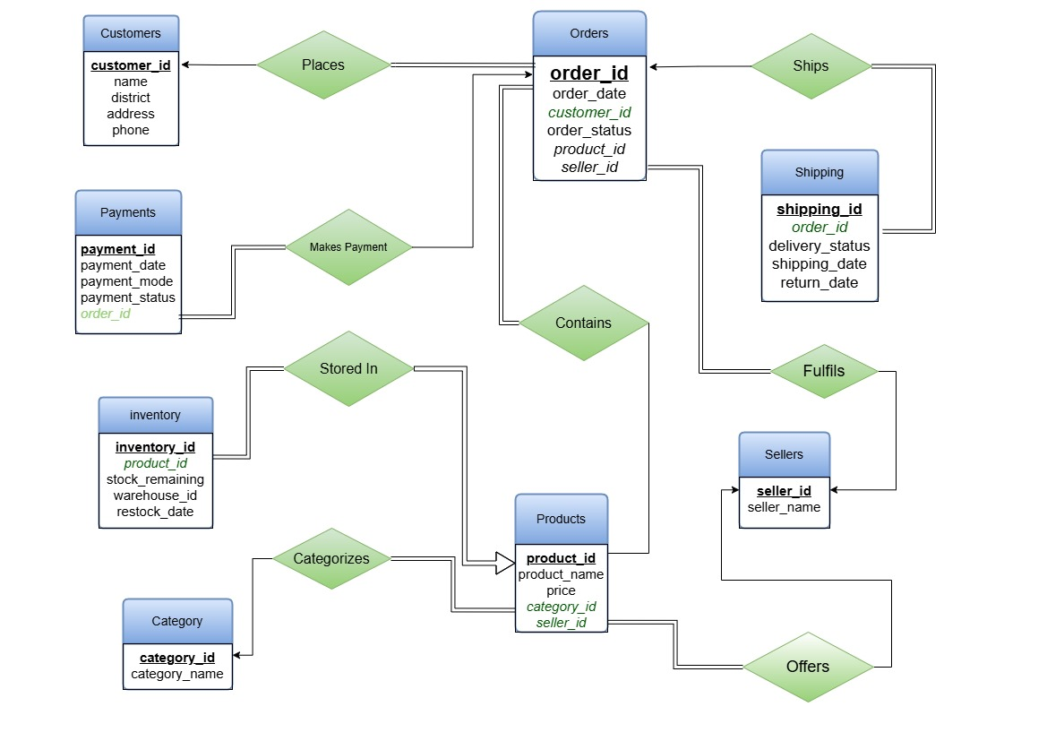
ER Diagram:

Slide 9
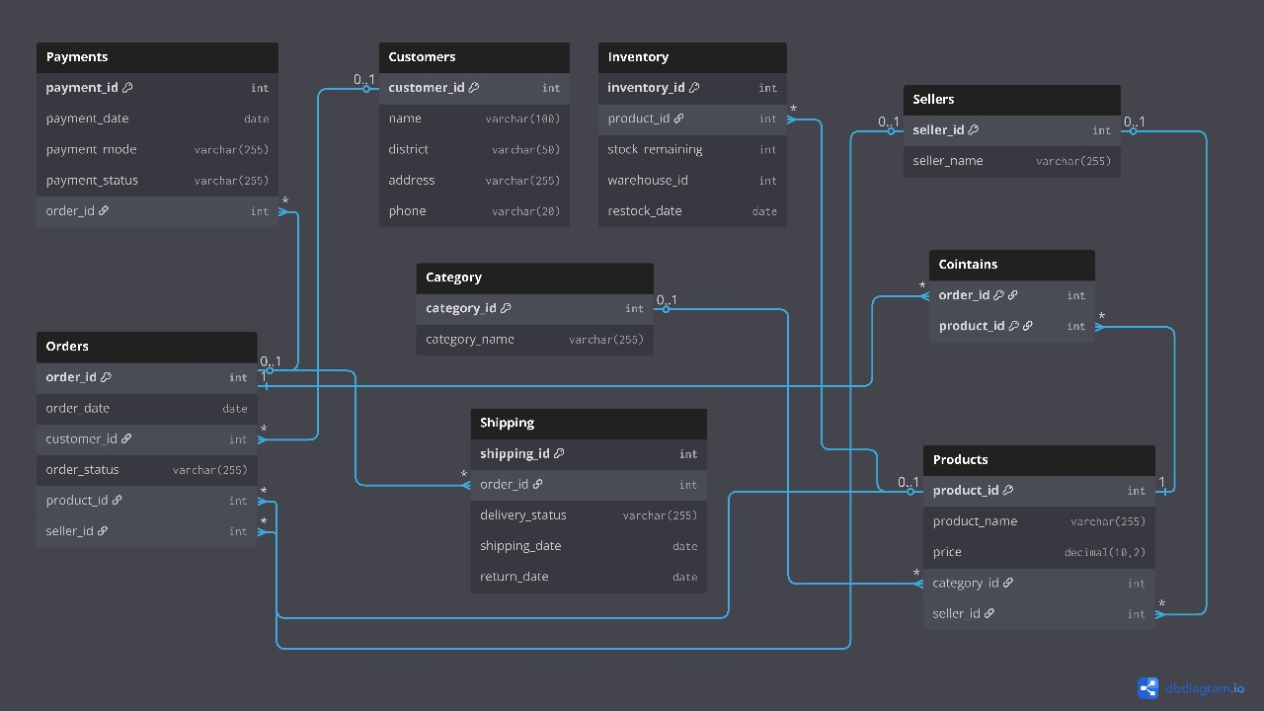
Schema Diagram :

Slide 10
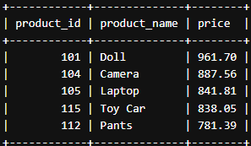
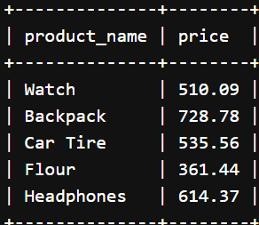
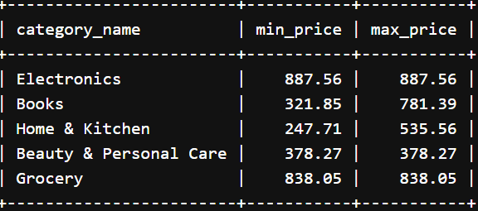
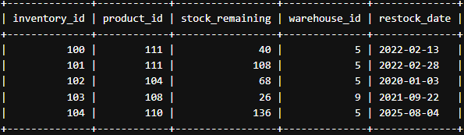
Query :
--3 All products ordered by price descending
SELECT product_id, product_name, price
FROM Products
ORDER BY price DESC
LIMIT 5;
-- 1. Find products priced between 300 and 800
SELECT product_name, price
FROM Products
WHERE price BETWEEN 300 AND 800
LIMIT 5;
-- 4. MIN and MAX product price per category
SELECT cat.category_name, MIN(p.price) AS min_price, MAX(p.price) AS max_price
FROM Products p
JOIN Category cat ON p.category_id = cat.category_id
GROUP BY cat.category_name
LIMIT 5;
-- 2. Update inventory table
UPDATE Inventory
SET stock_remaining = stock_remaining + 20
WHERE product_id = 105;
Select * FROM Inventory
LIMIT 5;

Slide 11
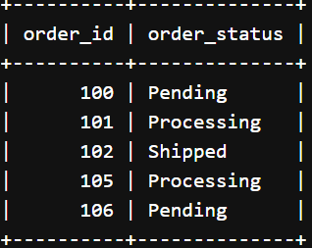
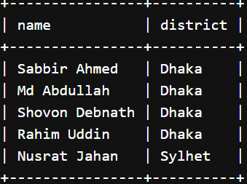

-- 5. Find customers from Dhaka or Sylhet
SELECT name, district
FROM Customers
WHERE district = 'Dhaka' OR district = 'Sylhet’
LIMIT 5;
-- 6. Find all orders that are not delivered
SELECT order_id, order_status
FROM Orders
WHERE NOT order_status = 'Delivered’
LIMIT 5;
-- 7 Query using SUM, AVG, COUNT from product
SELECT
SUM(price) AS Total_Product_Price,
AVG(price) AS Average_Product_Price, COUNT(product_id) AS Total_Products
FROM Products;

Slide 12
Conclusion :
This online shopping database project shows the value of a well-structured system for managing customers, sellers, products, and orders. It ensures smooth operations, data consistency, and scalability for future growth. The system also lays the foundation for enhancements like analytics, recommendations, and automated inventory management.

Slide 13


